Slide 1
Android Operating System
Presenters : ZiJian Chen, XinQi Chen, Zhili Mai, Bin Liu

Slide 2


Logo
First Android logotype (2007–2014)
Second Android logotype (2014–2019)

Slide 3
History
an operating system mainly for touchscreen devices, like smartphones, tablets, smartwatches, smart TVs.

Slide 4
Android Inc.
Android Inc. Was founded in October 2003
The original purpose of developing Android was for digital cameras
In July 2005, Google bought Android Inc. and main employees for at least $50 million

Slide 5
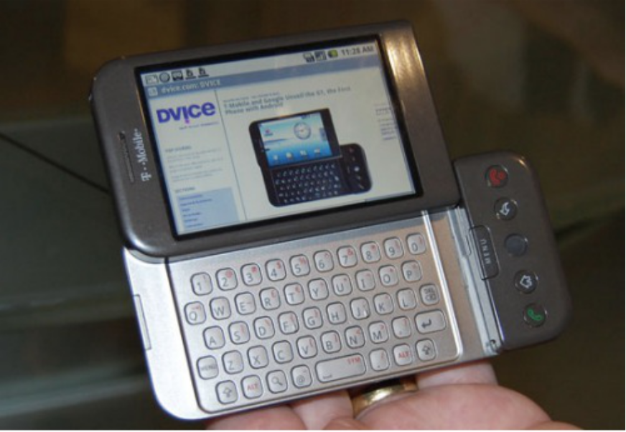
At Google
HTC Dream, aka T-Mobile G1

Slide 6

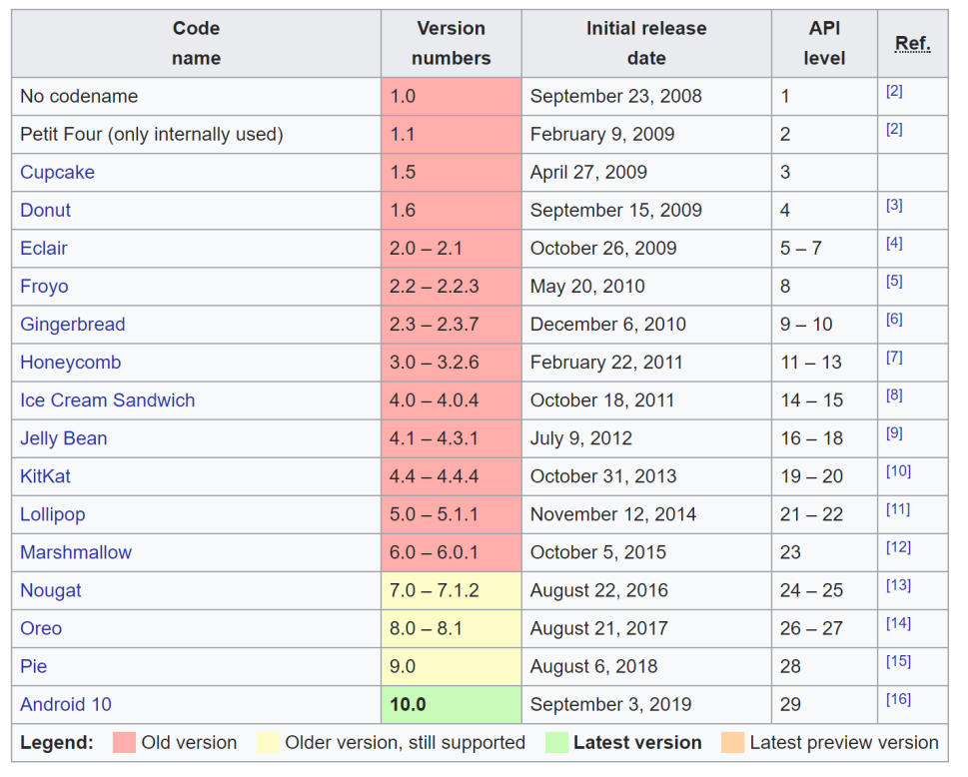
All versions of Android

Slide 7
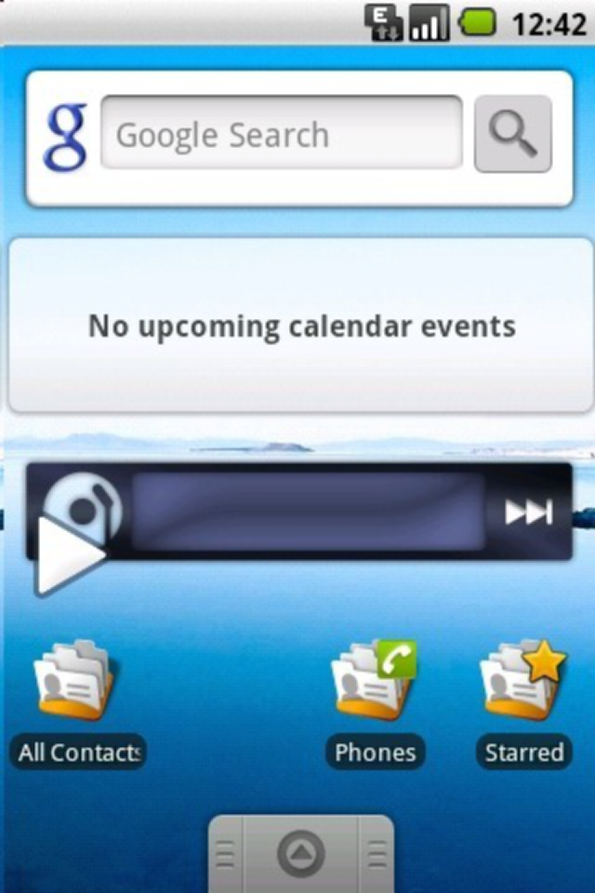
Cupcake – Android 1.5

Slide 8
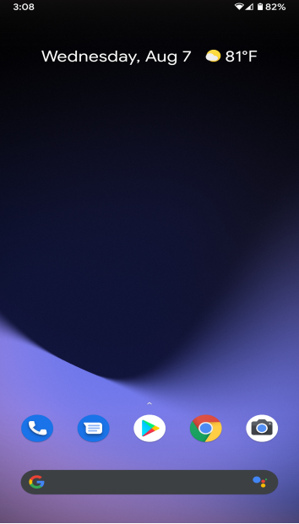
Android 10.0

Slide 9
Architecture

Slide 10
Platform Architecture
This is a layer approach.
Linux Kernel
Hardware Abstraction Layer (binderized – IPC, passthrough)
Native C/C++ Libraries and Android Runtime
Java API Frameworks
System App

Slide 11
Why Linux Kernel
Linux Security
User based security model
Process isolation
Filesystem Permissions
Notes:
Open source many people develop stable

Slide 12
How process runs (Android Runtime)
Dalvik Virtual Machine / Android Runtime
AOT / JIT
Uses Linux core feature
Each run in its own virtual machine
Notes:
Basically, it runs on user layer.

Slide 13
Pros & Cons

Slide 14
Pros of Android System
More feature
Easy and cheap to develop
Open source

Slide 15
Cons of Android System
Low Security
System performances
High device fragmentation
Notes:
Too many fake app, requesting many permission

Slide 16
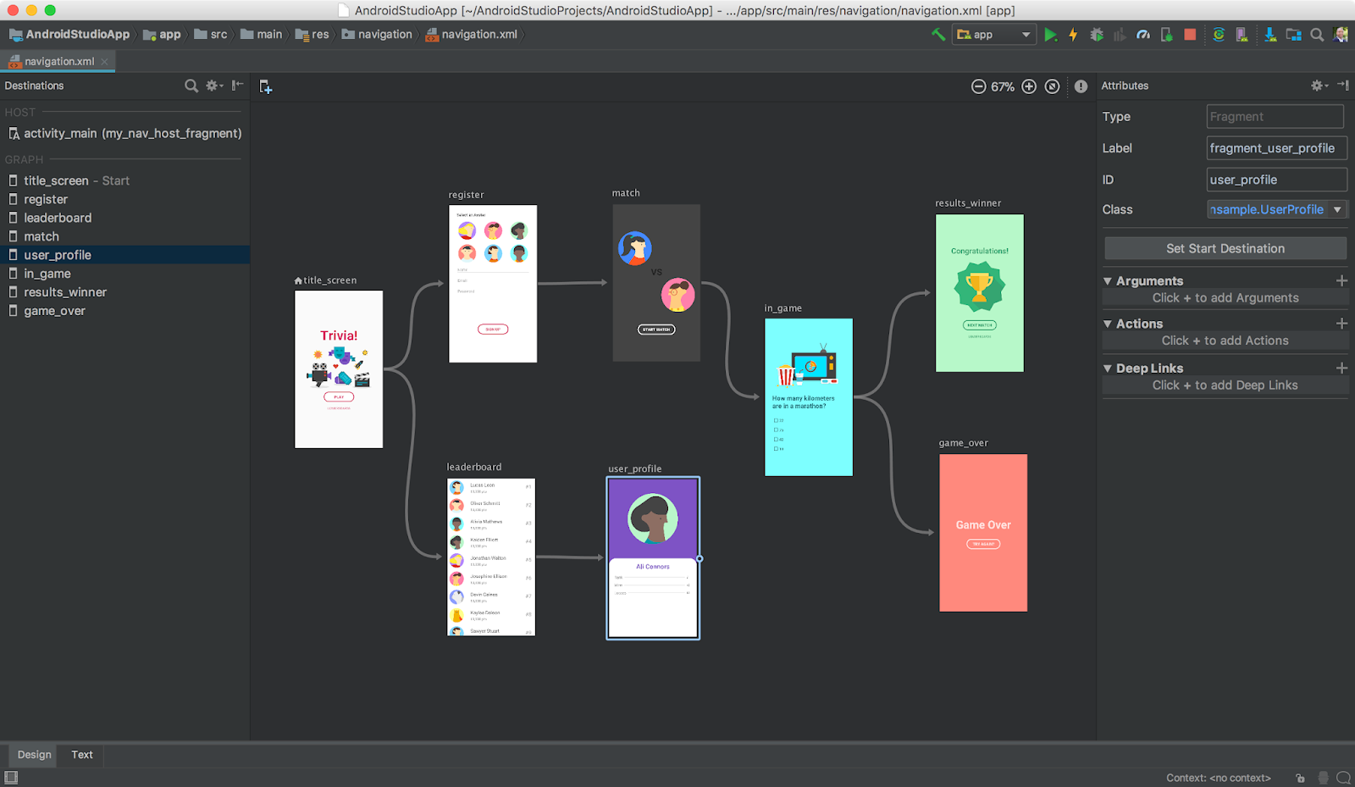
Android developing environment
Android Studio
( Official IDE )
IntelliJ IDEA
Eclipse Android Development Kit
(“Andmore”)

Slide 17
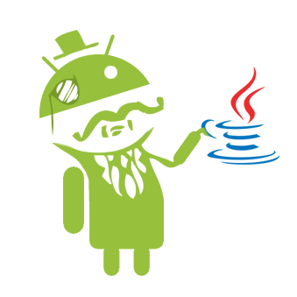
Programming languages for Android
The most common ways for Android developing :
Java (And other JVM languages)
Hybrid (using JS + HTML)
Other languages can also be used :
C/C++
Python
Scala

Slide 18
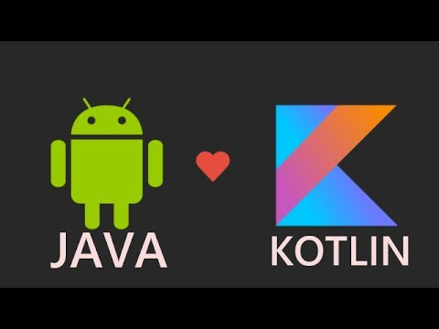
Java vs Kotlin
On May. 7th 2019, Google announced that Kotlin will be the preferred programming language for Android development
Kotlin is fully compatible with the Java programming language
Laconic
Better in Safety

Slide 19
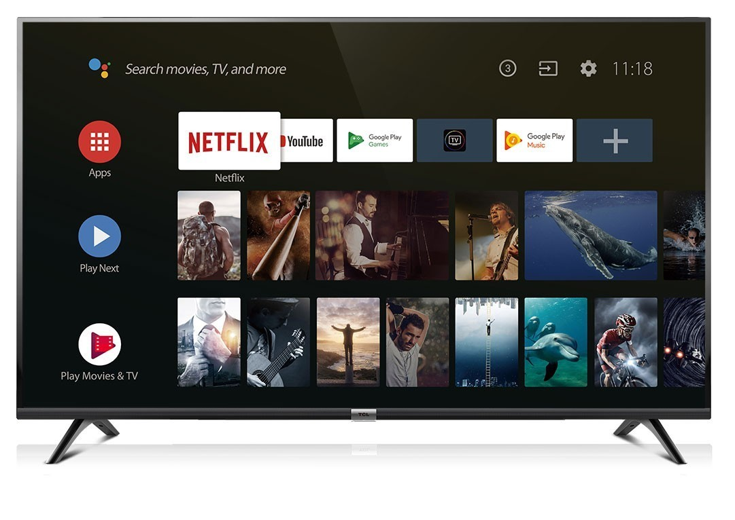
Application Of Android Operating System
Android OS is used by large of Smart Phone Companies: HUAWEI SAMSUNG ONEPLUS NOKIA
Also for Tablets and smart TV

Slide 20
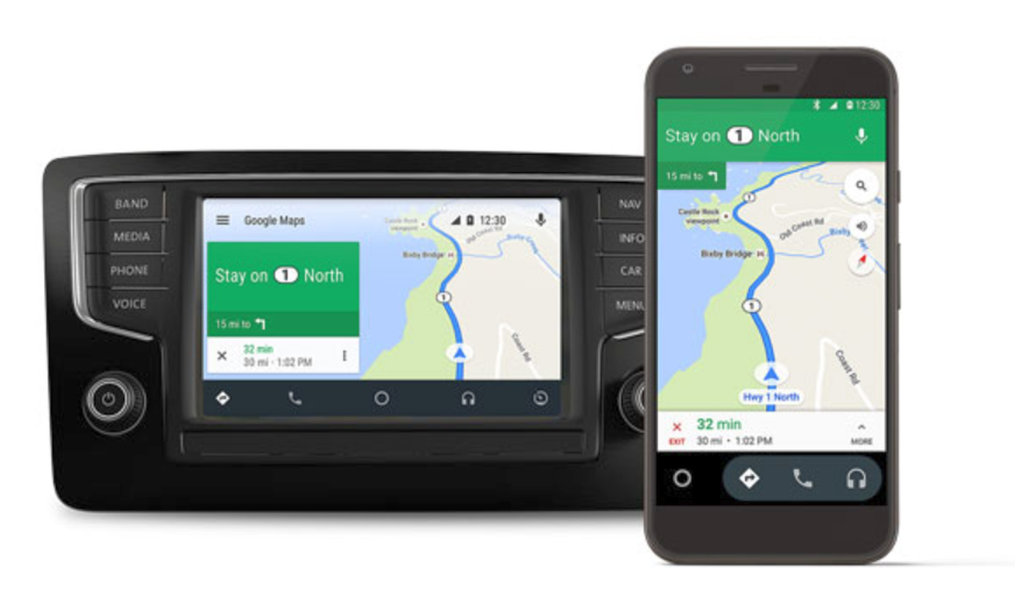
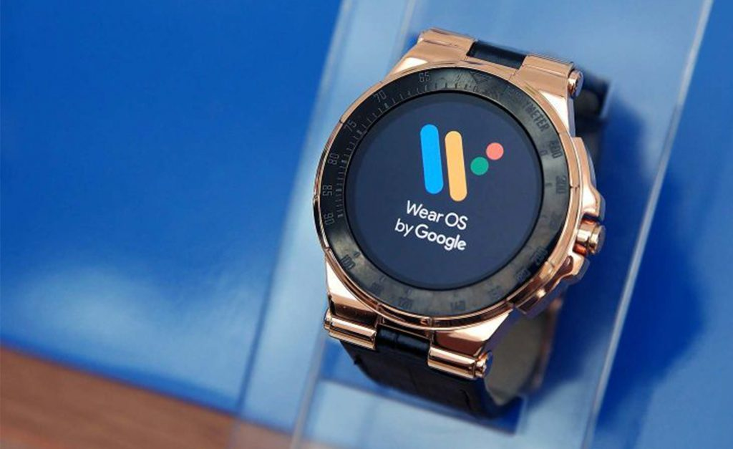
Android Auto and Wear OS
Based on Android system
Interact with Android Smart Phone

Slide 21
Market Share
2009
2012
2019

Slide 22
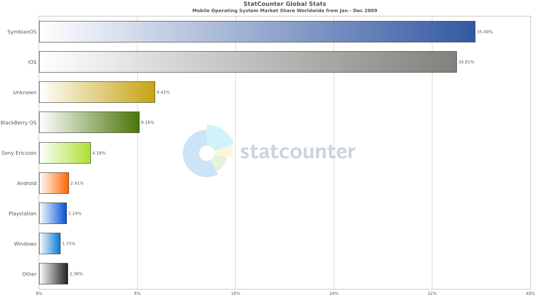
2009

Slide 23
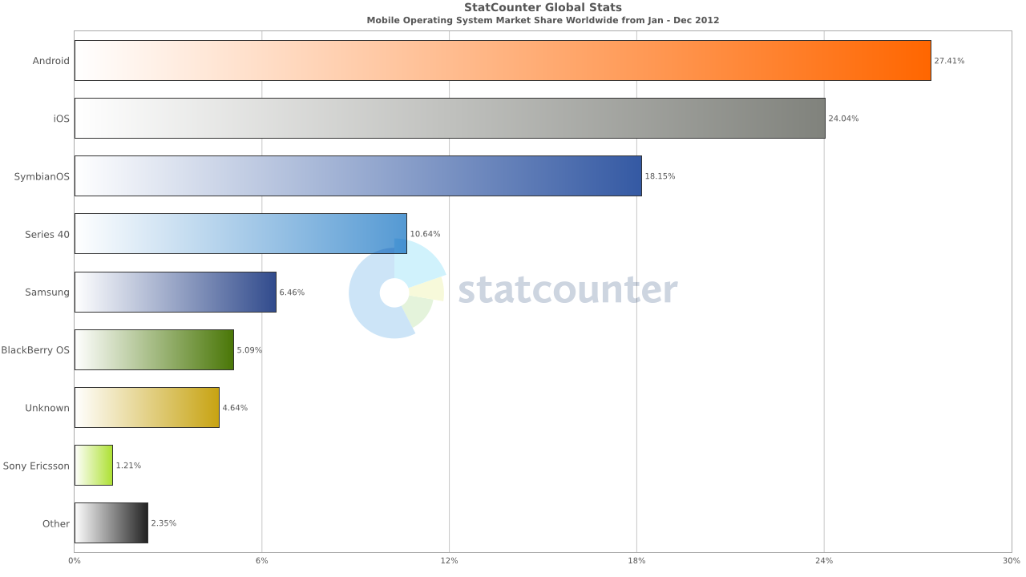

Slide 24
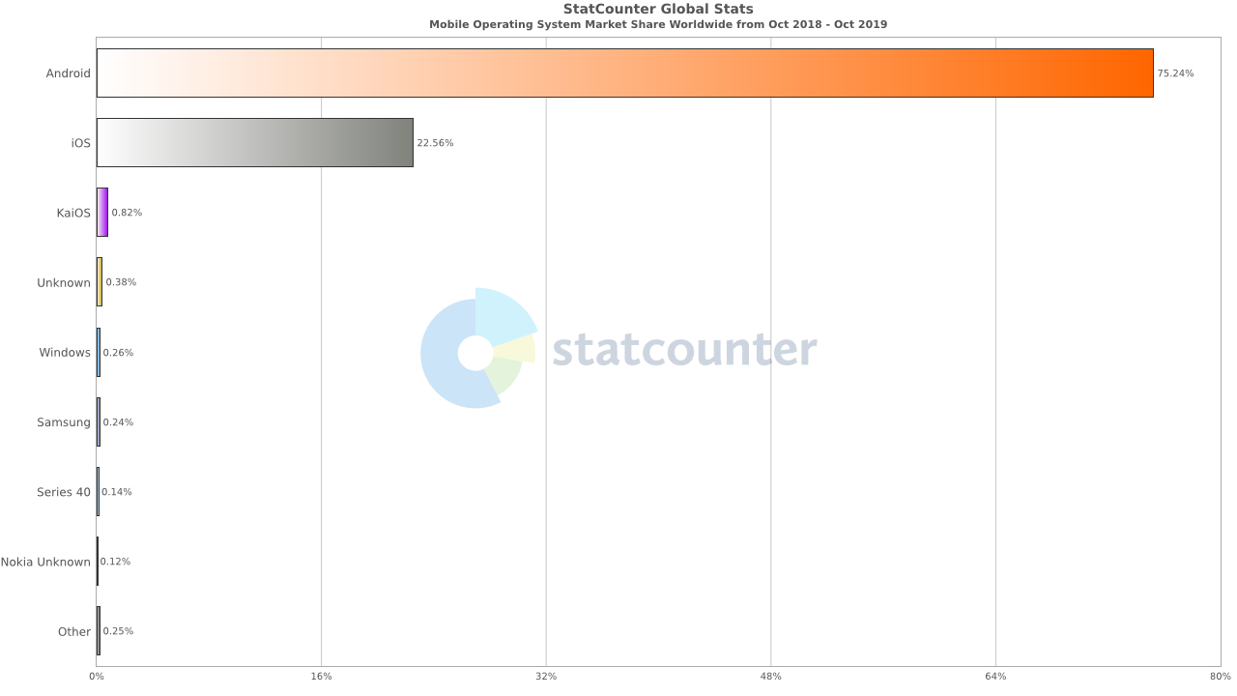
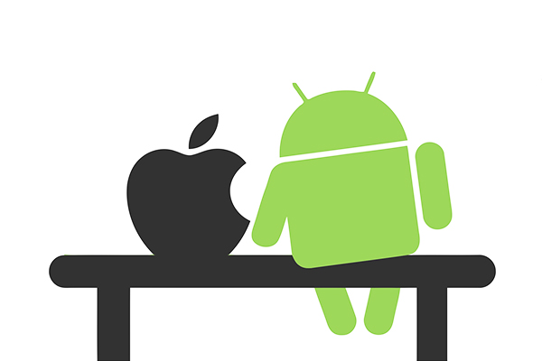
2019

Slide 25
Reference
https://source.android.com/security/overview/kernel-security.html
https://source.android.com/security/app-sandbox
https://source.android.com/security/overview/kernel-security.html
https://en.wikipedia.org/wiki/Android_(operating_system)
https://en.wikipedia.org/wiki/Android_version_history
https://www.androidauthority.com/history-android-os-name-789433/
https://kotlinlang.org/docs/reference/comparison-to-java.html
https://en.wikipedia.org/wiki/Android_Studio
https://www.xenonstack.com/blog/kotlin-andriod/
https://www.sitepoint.com/native-vs-hybrid-app-development/

